Slide 1
Mastering Distributed System Design
Attributes of Distributed Systems
Notes:
So, we understand the what and the why of system design. We know we're focusing on High-Level Design for distributed systems.
But this raises a critical question: What makes a distributed system good? What are the actual goals we are designing for?
In a single, simple application, success might be 'it works.' But in a distributed world, 'working' isn't enough. The system must work when millions of users hit it at once. It must work when a critical server catches fire. It must work for a user halfway across the globe. And it must continue to work as our team constantly changes and improves it.
These aren't nice-to-haves. They are the non-functional requirements that become our primary design drivers. They are the qualities we measure, argue about, and optimize for in every architecture meeting.
To design effectively, we need a shared vocabulary for these qualities. We need to define what we mean by a system that is robust, fast, and future-proof.
This brings us to the core Attributes of Distributed Systems. Think of these not as a checklist, but as a framework for thought—a set of interconnected, and sometimes competing, goals that will guide every single decision we make from here on out.

Slide 2
Attributes
Communication (The fundamental challenge: how components talk)
Consistency (Everyone sees the same data at the same time)
Availability (Can you get a response, even if it's stale?)
Reliability (Does the system behave correctly over time?)
Fault Tolerance (How it achieves reliability despite failures)
Scalability (How it handles increased load)
Durability (The guarantee that your data must persist and not be lost)
Maintainability (How we manage the system's evolution)

Slide 3
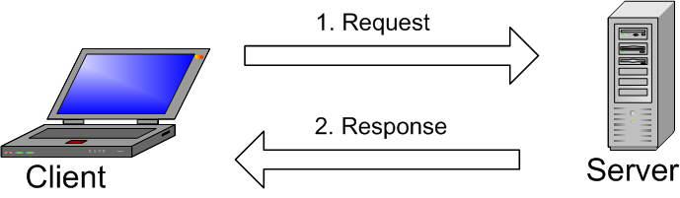
Communication
Communication is the first, foundational challenge of distributed systems.
All interaction happens over a network—an imperfect & unreliable medium.
Example: A web browser sending an HTTP request to a server.
Notes:
Let's begin with the first and most fundamental challenge in any distributed system: communication.
Every distributed system is, at its heart, a group of nodes—servers, services, devices—that need to talk to each other. And they do this over a network, which is not a perfect, reliable pipe. It's a complex, sometimes chaotic, shared medium.
Think of a simple web request. Your browser takes a URL, finds the server's address, and sends an HTTP request. The server processes it and sends back a response with the webpage. This seems straightforward, but a lot can go wrong between that request and response.
This forces us to ask some critical design questions:
First, representation: How are these messages—the request and the response—actually encoded into bits and bytes on the network wire?
Second, reliability: What happens during a temporary network blip, or if a faulty router corrupts part of our message? How does our system detect and recover from that?
Third, security: How do we guarantee that no one in the middle can eavesdrop on or tamper with this conversation?
Now, you might think, 'This is what my networking library handles for me.' And that's true to an extent. Libraries provide crucial abstractions.
But here's the key insight for system designers: abstractions leak. When a network partition happens or a strange timeout occurs, that underlying complexity bubbles up to your application layer. To debug it, to design for it, and to choose the right protocols and libraries, you need a solid understanding of how the network stack actually works.
So, communication isn't just about calling an API. It's about understanding the fragile, uncertain path your data takes and building your system's logic to survive the journey.

Slide 4
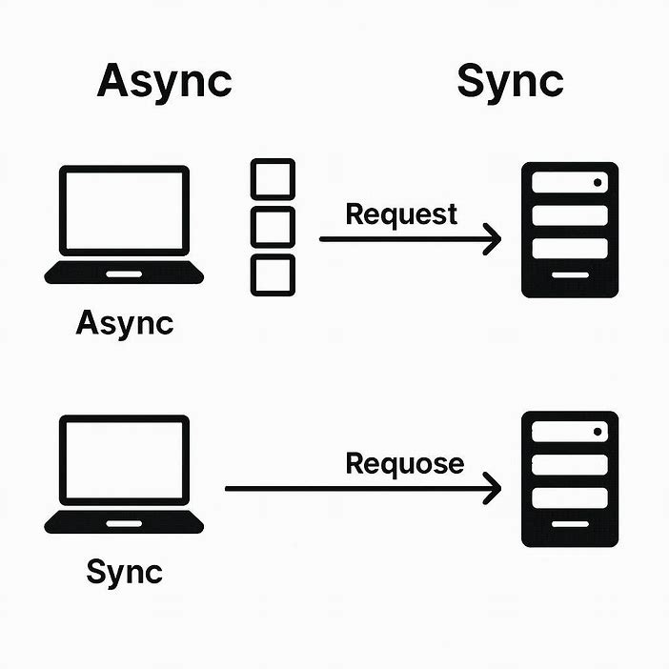
Communication Types
Synchronous: Sender waits for a response (like HTTP).
Asynchronous: Sender sends a message and moves on (like messaging queues).
Notes:
Now, a key design choice we must make is how components communicate. We have two fundamental patterns:
Synchronous communication, like the HTTP call I just described, where the sender waits—blocks—until it gets a response. It's direct and simple, but fragile: if the server is slow or down, the caller is stuck waiting.
Asynchronous communication, where a service sends a message—say, to a queue—and immediately continues its work. Another service picks up that message later and processes it. This decouples the components, making the system more resilient, but it adds complexity in tracking and guaranteeing message delivery.
Now, you might think, 'This is what my networking library handles for me.' And that's true to an extent. Libraries provide crucial abstractions for both synchronous and async patterns.

Slide 5
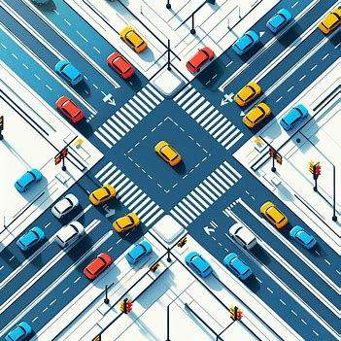
Coordination
Coordination is how nodes make collective decisions and maintain consistent state.
It's essential for Reliability (correct behavior) but often conflicts with Scalability.
Notes:
Beyond just communicating, distributed systems face a second, even trickier challenge: coordination.
While communication is about exchanging messages, coordination is about agreeing on what those messages mean and making collective decisions. This is the mechanism that allows a distributed system to act as one coherent unit rather than a collection of independent parts.
Why is coordination so critical? Because it directly enables Reliability—the system working correctly over time. Without coordination, nodes might make conflicting decisions, corrupt data, or create inconsistent states. Think about a distributed database: if two nodes try to update the same record simultaneously without coordinating, you get data corruption.
But here's the crucial tension: coordination often comes at the cost of Scalability. The more nodes need to coordinate, the more they need to communicate and wait for each other, creating bottlenecks. This is why you'll hear about the CAP theorem later—you often have to choose between strong Consistency (requiring coordination) and Availability/Scalability.
To understand why, let’s look at a famous thought experiment: The Two Generals Problem.
Imagine two armies, each led by a general, positioned on two hills overlooking a city. To succeed, they must attack at the exact same time. The only way to coordinate is by sending messengers through the valley between them—and any messenger can be captured by the enemy.
So, General 1 sends a messenger: 'Let’s attack at dawn.' But did the message get through? General 1 doesn’t know. To be sure, General 2 could send a confirmation: 'Got it, dawn it is.' But now, did that confirmation arrive? General 2 doesn’t know. You see the trap: every acknowledgment itself needs an acknowledgment.
No matter how many rounds of confirmation you add, you can never achieve absolute certainty that both generals will attack together. This isn’t just a story—it’s a mathematical proof that perfect coordination over an unreliable network is impossible.
This reveals the profound difficulty of coordination in real systems. It’s why we need sophisticated algorithms—like consensus protocols—to reach practical, if not perfect, agreement.
Because this topic is so foundational, the entire second part of this book is dedicated to the distributed algorithms that make coordination possible in the imperfect world we build in.

Slide 6

Consistency
Definition: The guarantee that all users see the same data at the same time.
Core Problem: Data is replicated across multiple nodes for reliability and performance.
The Challenge: How do we keep all copies synchronized when updates occur?
The Goal: Make the distributed system behave like a single source of truth.
Real-World Example: Your bank balance must be consistent across all ATMs, apps, and branches.
Notes:
After communication and coordination, we come to one of the most discussed attributes: Consistency.
In simple terms, consistency is the promise that everyone sees the same thing at the same time. Imagine you and a friend are both looking at the same social media post on your phones. If you refresh and see 10 likes, but your friend sees 11, that's an inconsistency. For a social post, maybe that's okay. But for your bank account balance? That inconsistency is completely unacceptable.
So, we define consistency as the guarantee that data is uniform and accurate across all parts of a distributed system. The goal is to make a system with many copies of data behave as if there's just one single source of truth.
Why is this so hard? Because in a distributed system, we replicate data across different servers for reliability and speed. When an update happens—say, you add a 'like'—the system must now update all those copies. Doing this instantly and perfectly requires a lot of coordination and communication, which we just learned is difficult and slow.
But achieving this perfect consistency comes with trade-offs that force us to make design choices. This brings us to the different types of consistency models we can implement.

Slide 7
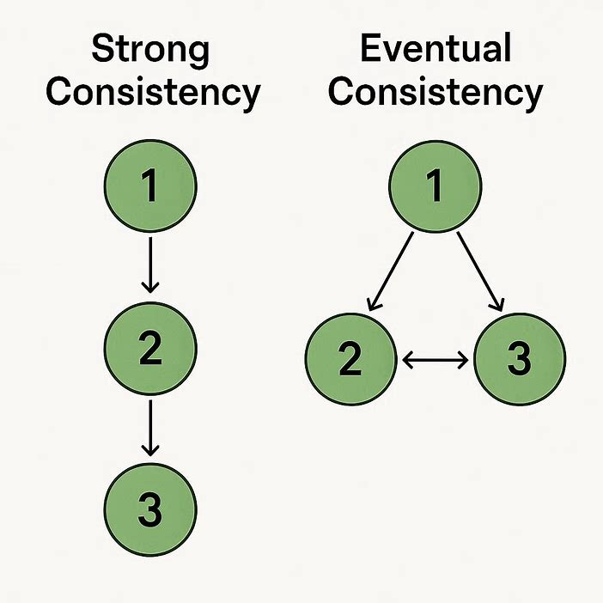
Consistency Models
Strong Consistency
                All nodes see the latest write immediately.
                The system acts like a single, up-to-date copy.
                Can be slower and may reduce availability during failures.
Eventual Consistency
Given no new updates, all nodes will eventually see the same value.
Temporary inconsistencies are allowed; they resolve over time.
Higher availability and better performance.
Notes:
Because perfect consistency is so costly, we've developed different consistency models that let us make intelligent trade-offs based on our application's needs.
This leads to the fundamental trade-off. Strong Consistency—where every user always sees the latest data—can make the system feel slower or even become unavailable if a node fails. Sometimes, we consciously choose weaker Consistency for the sake of better availability and speed, accepting that users might briefly see stale data.
Think of it this way:
Your bank account requires strong consistency. Every transaction must be instantly reflected everywhere.
A social media 'like' counter can often use weaker consistency. It's acceptable if the number is slightly off for a second.
Getting this trade-off right is at the heart of designing data systems.
On one end, we have Strong Consistency. This is the strictest model. Here, the system guarantees that any read operation will return the most recent write. It makes the entire distributed database feel like a single, up-to-date server. This is non-negotiable for systems like banking or stock trading. The cost? It can be slower, as the system must coordinate to update all copies before confirming a write, and it might become unavailable if parts of the system fail.
On the other end, we have Eventual Consistency. This model prioritizes availability and speed. It allows different nodes to have slightly different data for a short period. The guarantee is simple: if you stop making updates, eventually all nodes will settle on the same value. This is perfectly acceptable for features like social media likes, comments, or a non-critical product catalog. You get a faster, more resilient system in exchange for temporary inconsistency.

Slide 8
Availability
A measure of whether a system is operational and able to respond to requests.
The system can respond to requests (even if with degraded performance).
Availability (%) = [(Total Time - Total Downtime) / Total Time] × 100
Notes:
Let's talk about Availability - one of the most user-visible attributes of any system.
At its core, availability is about accessibility. It answers the question: 'Can users reach and use the service right now?' When you click on an app icon, availability determines whether you get a working interface or an error message.
Think of it like a store's opening hours. A 24/7 convenience store has near-perfect availability - you can almost always get in. A bank with 9-to-5 hours has lower availability - there are times when you simply cannot access the service.

Slide 9
Measuring Availability
Availability % | "Nines" | Downtime per Year | Downtime per Month
99% | Two Nines | 3.65 days | 7.3 hours
99.9% | Three Nines | 8.76 hours | 43.8 minutes
99.99% | Four Nines | 52.6 minutes | 4.38 minutes
99.999% | Five Nines | 5.26 minutes | 25.9 seconds
99.9999% | Six Nines | 31.5 seconds | 2.59 seconds
99.99999% | Seven Nines | 3.15 seconds | 0.26 seconds
Notes:
In distributed systems, we measure availability in 'Nines' - and each additional nine represents a quantum leap in reliability engineering.
Look at this table. 99% availability - that's 'two nines' - sounds pretty good, right? But it means 3.65 DAYS of downtime per year. For most online businesses today, that's completely unacceptable.
Now look at 99.99% - 'four nines'. That's just 52 minutes of downtime per year. And 99.999% - 'five nines' - is only 5 minutes per year.
This progression isn't linear - it's exponential. Going from 99% to 99.9% means reducing downtime from 87.6 hours to 8.76 hours per year. That's a 90% improvement with just one additional nine.
But here's the catch: each additional nine typically costs 10 times more to achieve. The infrastructure, redundancy, monitoring, and engineering effort required for five nines versus three nines is enormous.
Most consumer web services aim for three to four nines. Mission-critical systems like financial exchanges or emergency services might target five nines. Very few systems truly achieve six or seven nines - we're talking about seconds of downtime per year.

Slide 10
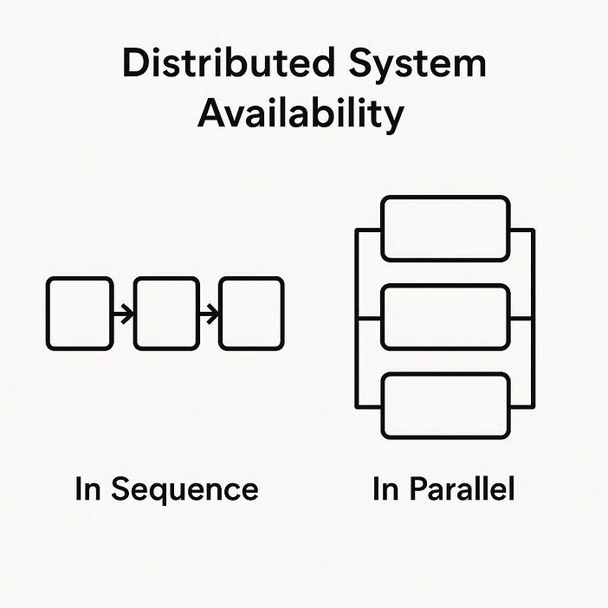
Availability in Sequence vs Parallel
A_series = A1 × A2 × A3 × ... × An
Example: 0.99 × 0.99 × 0.99 = 0.97 (97%)
A_series = A1 × A2 × A3 × ... × An
Example: 0.99 × 0.99 × 0.99 = 0.97 (97%)
Notes:
Now let's understand how system architecture affects availability. Consider two fundamental arrangements: Sequence and Parallel.
In a sequence system, components are chained together like links in a chain. The user's request must pass through every component successfully. Think: web server → application server → database. If any one fails, the whole system fails.
The math here is brutal: You MULTIPLY the availabilities. If you have three components, each with 99% availability (0.99), your overall system availability is 0.99 × 0.99 × 0.99 = 0.97, or 97%. Three components reduced your system's availability!
"In a parallel system, components are redundant. The system works if ANY of the components work. Think: multiple web servers behind a load balancer. If one fails, others handle the traffic.
The math here is much friendlier: Availability = 1 - (probability ALL fail). With two components each at 99%, the probability both fail is 0.01 × 0.01 = 0.0001. So system availability is 1 - 0.0001 = 0.9999, or 99.99%!
This is why we build redundancy into critical paths. We transform series dependencies into parallel ones wherever possible. Load balancers with multiple servers, database replicas, multiple network providers - these all create parallel paths that dramatically boost availability.

Slide 11
Availability Patterns
Failover
Replication

Slide 12
Understanding Failover
The automatic process of switching to a standby system when the primary system fails
Notes:
Before diving into specific patterns, let's understand the fundamental concept of Failover.
Failover is the automatic process of switching to a backup or standby system when the primary system fails. The goal is simple: keep the service running even when individual components fail.
Think of it like a spare tire in your car. When your main tire gets a flat, you don't abandon the car - you switch to the spare and continue driving. In systems, when our primary server fails, we automatically switch to a standby server so users can continue using the service.
The process has four key steps:
First, continuous monitoring - we're constantly checking if the primary system is healthy.
Second, failure detection - we identify when something is wrong.
Third, automatic switchover - we redirect traffic to the standby system.
Fourth, recovery - we can fix the primary and bring it back online.
This automatic detection and switching is what distinguishes failover from manual recovery. Without failover, every failure requires human intervention, causing longer outages.
Failover addresses one of our core availability principles: eliminating single points of failure. If one component can take down your entire service, you need failover."

Slide 13
Types of Failover
System-Level Failover - Entire server or VM fails over
Service-Level Failover - Specific service fails over
Component-Level Failover - Specific component fails over
Notes:
Failover comes in different flavors depending on what's failing over and how.
First, by scope: We have system-level failover where an entire server or virtual machine moves to backup hardware. This is common in virtualization platforms. Then service-level failover where just a specific service - like our database - moves to another node while other services stay put. And component-level failover for individual hardware pieces like network cards or storage arrays.
Second, by timing: Automatic failover happens immediately when failure is detected - no human needed. Manual failover requires an administrator to initiate the switch. Semi-automatic is a hybrid - the system detects the failure and suggests failover, but a human confirms.
Third, by direction: Unidirectional failover goes one way - from primary to backup. Bidirectional means we can fail back to the original once it's repaired.
The choice depends on your requirements: How fast must recovery be? How critical is the service? What resources are available for monitoring and automation?

Slide 14
Failover Flavors: Active-Passive vs Active-Active
Active-Passive
Primary: 🟢 ACTIVE (handling 100% traffic)
Secondary: 🔵 STANDBY (idle, ready)
Arrow: Traffic → Primary only
Failure: Switch to Standby
Active-Active
Server A: 🟢 ACTIVE (handling 50% traffic)
Server B: 🟢 ACTIVE (handling 50% traffic)
Load Balancer: Distributes traffic
Failure: Redistribute to remaining servers
Notes:
Now that we understand failover basics, let's examine the two fundamental architectures: Active-Passive and Active-Active.
Think of them like a sports team. In Active-Passive, you have a starting player and a substitute on the bench. The starter plays the whole game unless injured, then the substitute jumps in. One is active, one is passive.
In Active-Active, you have multiple players on the court simultaneously, all contributing. If one gets tired or injured, the others cover and take on more load. All are active.
Both achieve failover but with different approaches and trade-offs. Let's explore each in detail.

